Slide 1
The 3.6m Devasthal optical Telescope and optical transients
S. B. Pandey
ARIES, Nainital, India
SN 1987A, Quark Phase Transition in Compact Objects
and Multi-messenger Astronomy, 02-08 July, 2017

Slide 2
Motivation for the 3.6m DOT and back-ends
Direct access to Indian astronomers for a 4-m class optical telescope with high resolution spectral
and seeing-limited imaging capabilities at visible and near-infrared bands, catering to a broad
range of astronomy research programs.
2. Follow-up optical studies of sources identified in the radio region by GMRT and UV/X-ray
by ASTROSAT.
3. Over 12 hours longitudinal gap over globe between the locations of 4-m class optical facilities –
Indian site crucial for time-critical and multi-site astronomical observations.
4. Synergy with the existing 2-m class optical observing facilities.
5. Building up of technological know-how for astronomy needs within the country.
6. Participation of India towards projects like Thirty Meter Telescope.

Slide 3
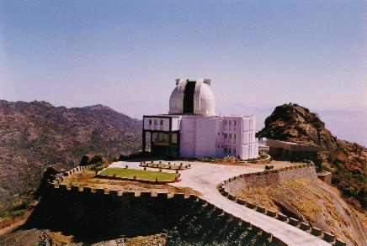
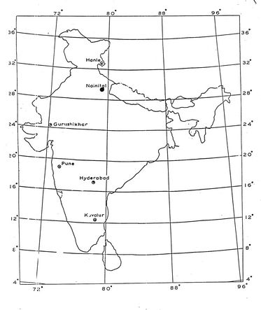
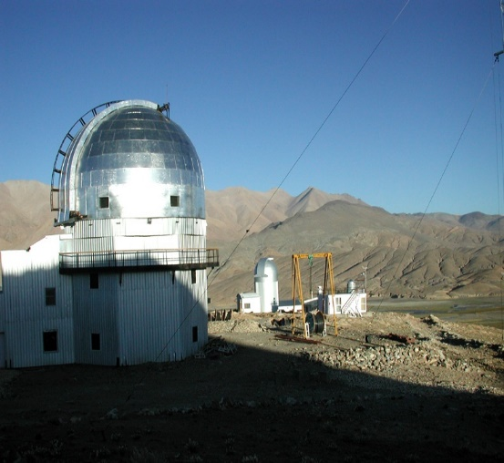
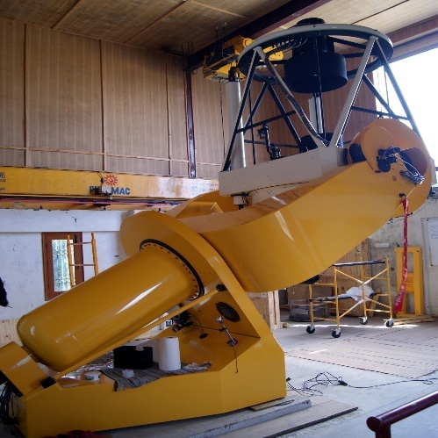
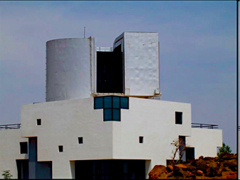
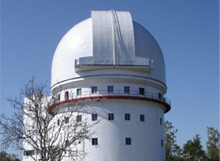
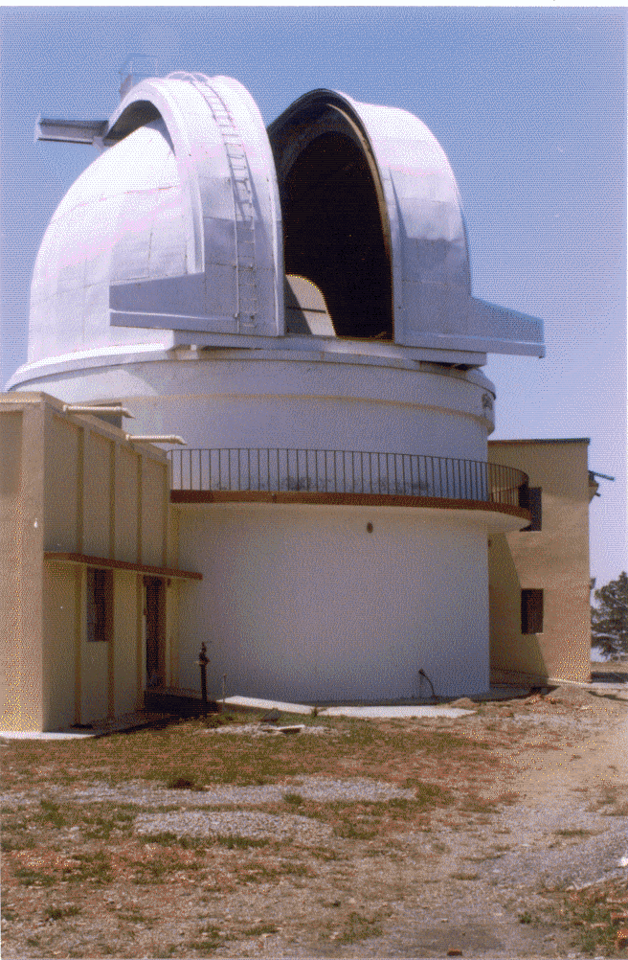
1.2 m
Alt = 1.7 km, 1980
2-m HCT, Hanle; Alt = 4.5 km, 2000
2 m at Girwali
Alt = 1 km, 2006
1.3 m DFOT
2.5km alt, 2010
1.04 m ST, Nainital
Alt = 2 km
1972
2.34 m VBT, Kavalur
Altitude = 0.8 km
1.2 m
Japal Rangapur
Alt = 0.7 km, 1972

Slide 5
The 3.6m DOT Project Time-line
Telescope : 2007/03 – 2013/03
Telescope building : 2014/06
Al-Coating plant : 2015/02
Dome Control software : 2015/03
AIV of telescope at Devasthal : 2014/10 – 2015/03
First light and Acceptance tests : 2015/12
Technical activation : 2016/03
First time allocation : 2017/04

Slide 6
Basic Configuration, 3.6m DOT
> Cassegrain focus as an optimization for imaging,
spectroscopic, polarimetric observations
> Science field of view : half degree
> 80% encircled energy diameter
in less than 0.45 arcsec
(Not more than 10% degradation
of 0.7 arcsec FWHM seeing)
> Compact (alt-azimuth) and
seeing-limited (Active optics)‏ Telescope

Slide 7
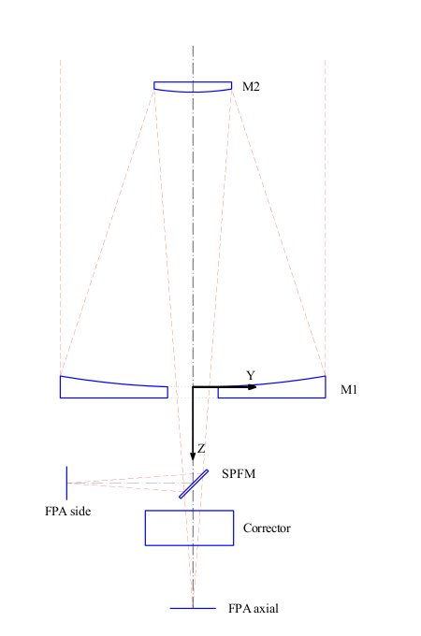
The Optics
F/9, Ritchey-Chretien
2 side ports, 1 axial port
FoV : 10 arcmin on side ports
: 30 arcmin on axial port
350 – 5000 nm
M1 : 3.6m optical dia, F/2,
RMS WFE < 40 nm
M2 : 0.95m optical dia,
RMS WFE < 30 nm
Plate scale : .06 arcsec / 10 micron

Slide 8
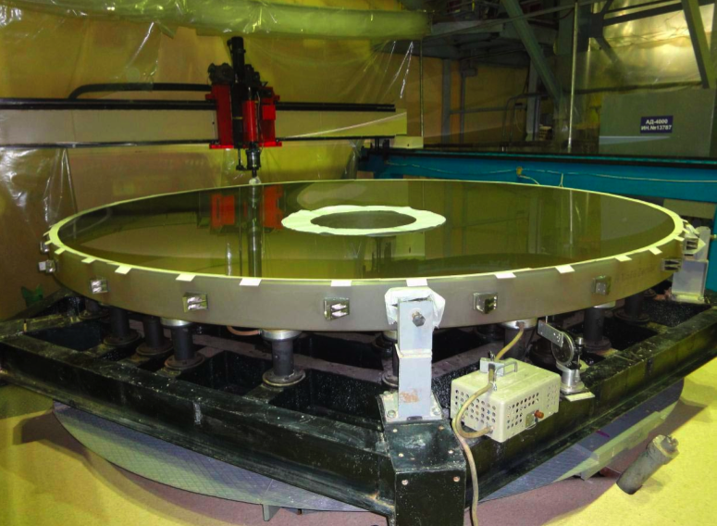
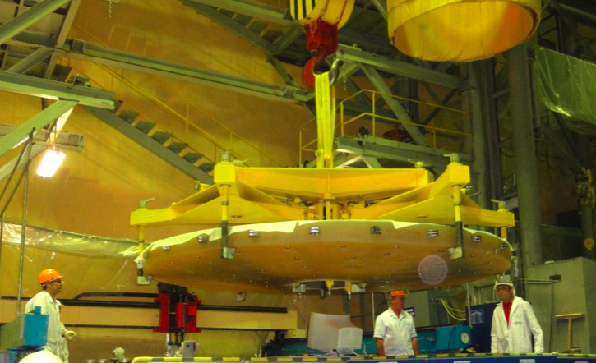
The Primary Mirror
Zerodur glass (Schott Germany);
meniscus with thickness 17 cm,
dia 370 cm and weight 4 Ton.
polished with accuracies ~33 nm rms.
Figuring and polishing took 20 months.

Slide 9
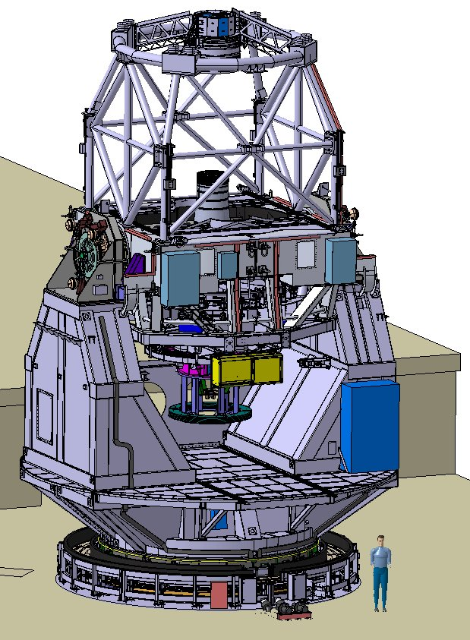
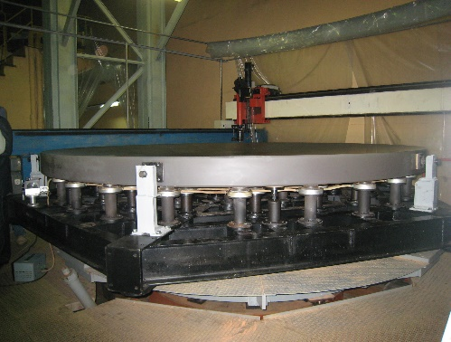
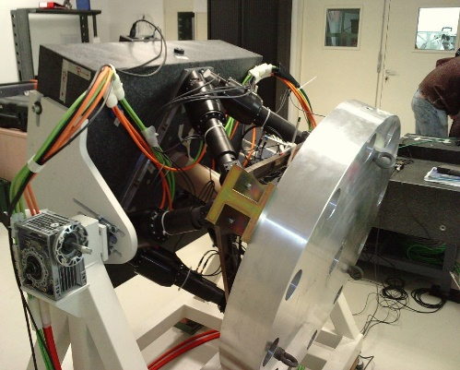
The Telescope
Alt-az | Active control of M1 and M2
seeing-limited resolution
Pointing accuracy :
< 2 arcsec RMS
Tracking accuracy :
< 0.1 arcsec rms in 1 min (without guider)
< 0.1 arcsec rms in 1 hr (with guider)
Image quality :
E80 < 0.45 arcsec (0.3 arcsec-FWHM)

Slide 10

Primary Mirror Active supports
69 axial actuators
(active push only)‏
- 7 nm Resolution
- 0.2 N accuracy
- 10-1000 N range
- 1.5 W/actuator
24 lateral supports
(passive static)‏

Slide 11
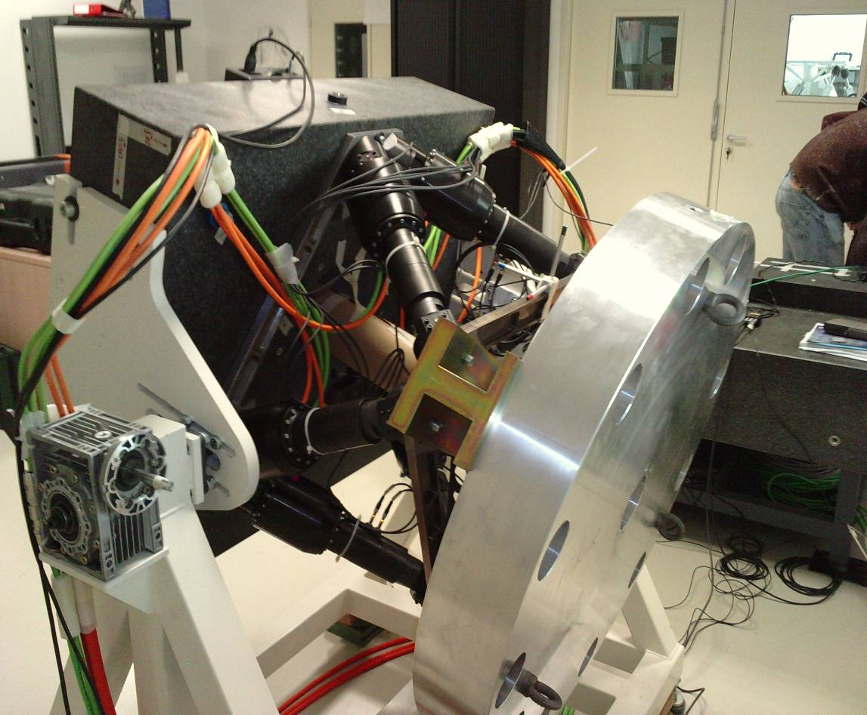
Secondary Mirror Hexapod
Six -degrees of freedom
Tx, Ty, Tz; Rx, Ry, Rz
Focus (Tz) – 1 μm
Centering (Tx,Ty) – 7.5 μm
Tip/Tilt (Rx,Ry) – 1 arcsec

Slide 12
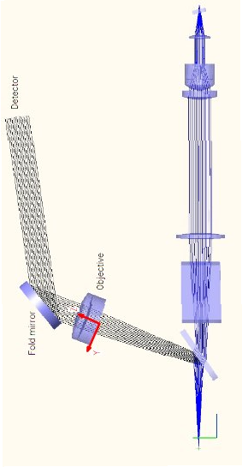
Auto-guiding and wavefront sensor Unit
Guider : 550-750 nm ; WFS : 400-550 and 750-900 nm

Slide 13
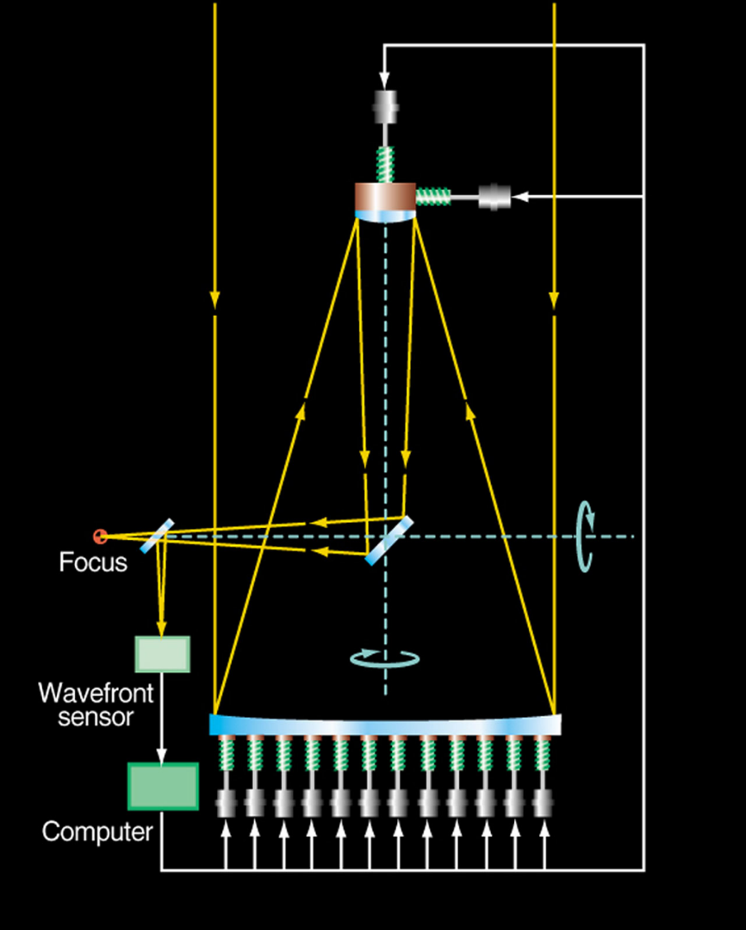
Active optics system
A low-frequency system that
detects and corrects deformations,
aberrations or any other phenomena
that degrade the image quality.
Wave front sensor
M1 support system
M2 hexapod
Telescope control system

Slide 14
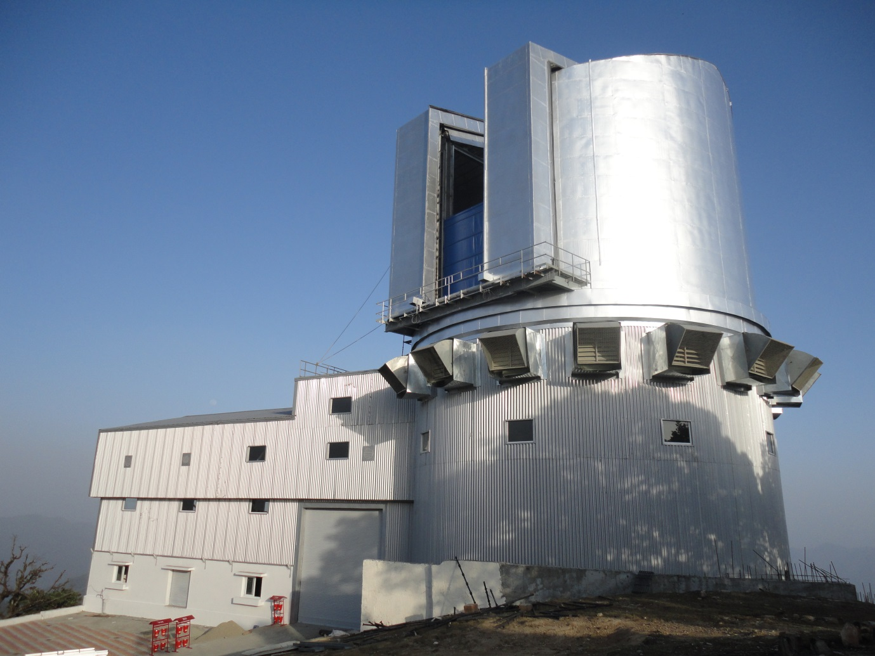
As-built Telescope Building
Steel structure
30m height, weighs 500T
Rotating dome weighs
175 Ton, 6.5m diameter
Equipped with
> ventilation fans;
> hot-air duct
> Insulated from day-heat
> Fire safety, pest control

Slide 15
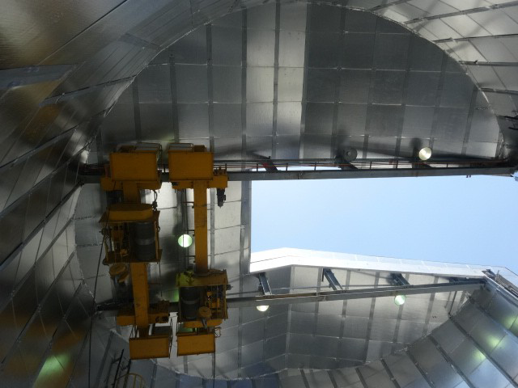
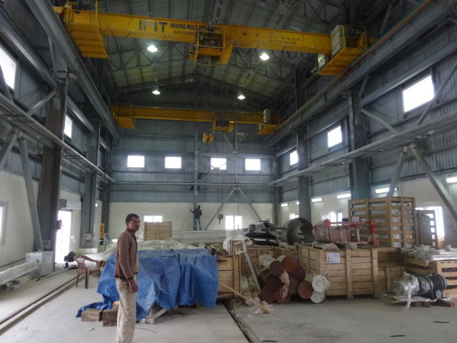
The overhead cranes
(June 2014)
Capacity : 10 Ton
Hoisting : 3 mm/s
Design consultancy : M/s PPS, Pune
Construction : M/s IMT, Govindgarh

Slide 16
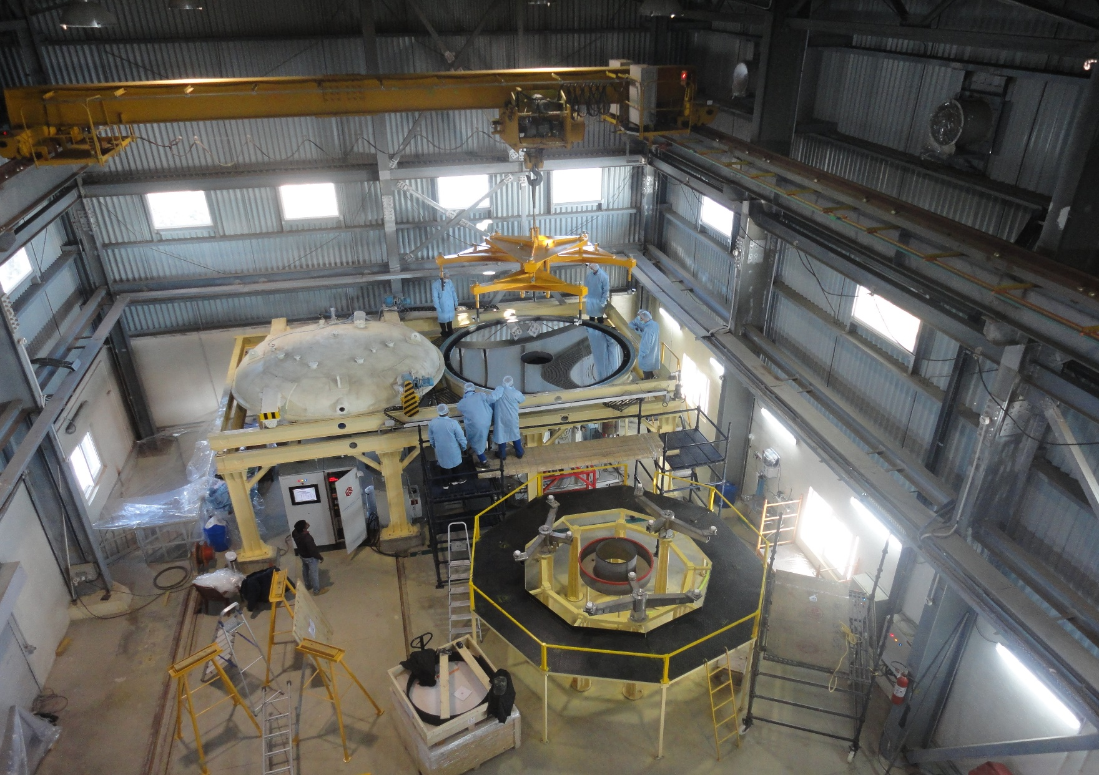
Installation of Aluminium coating plant
M1 Mirror coated successfully at Devasthal
2014 Nov to 2015 Feb
Design consultancy : M/s PPS, Pune
Construction : M/s HHV, Bangalore
> Reflectivity : 86%
> Uniformity : 2 nm

Slide 17
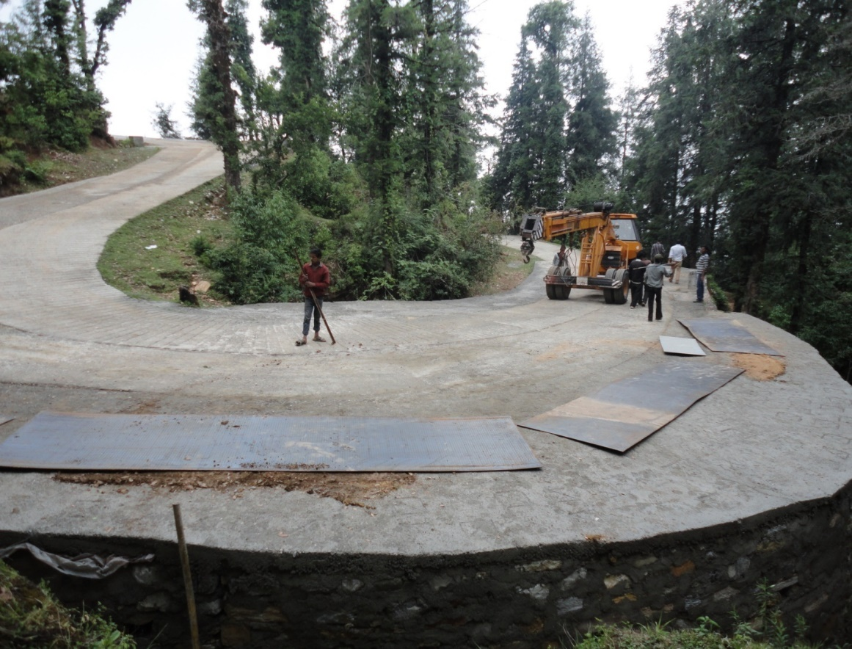
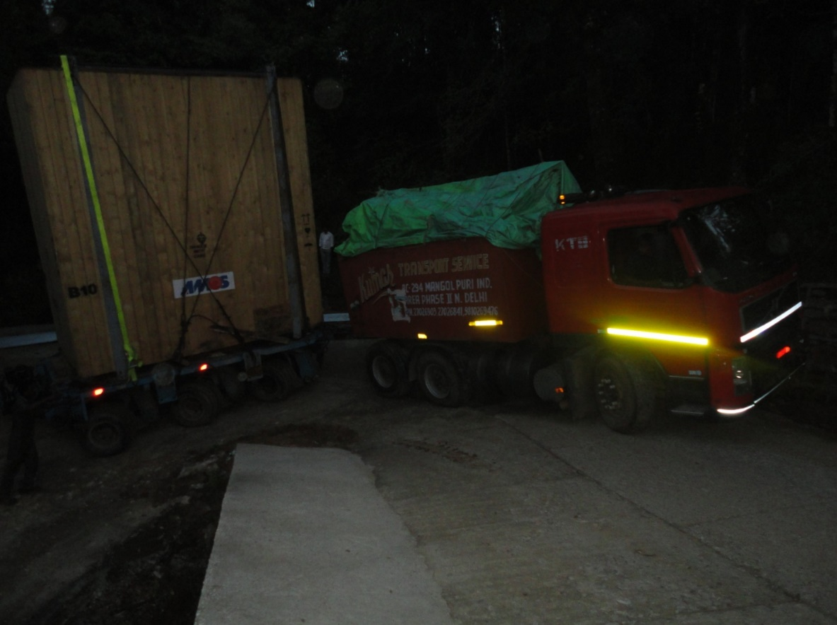
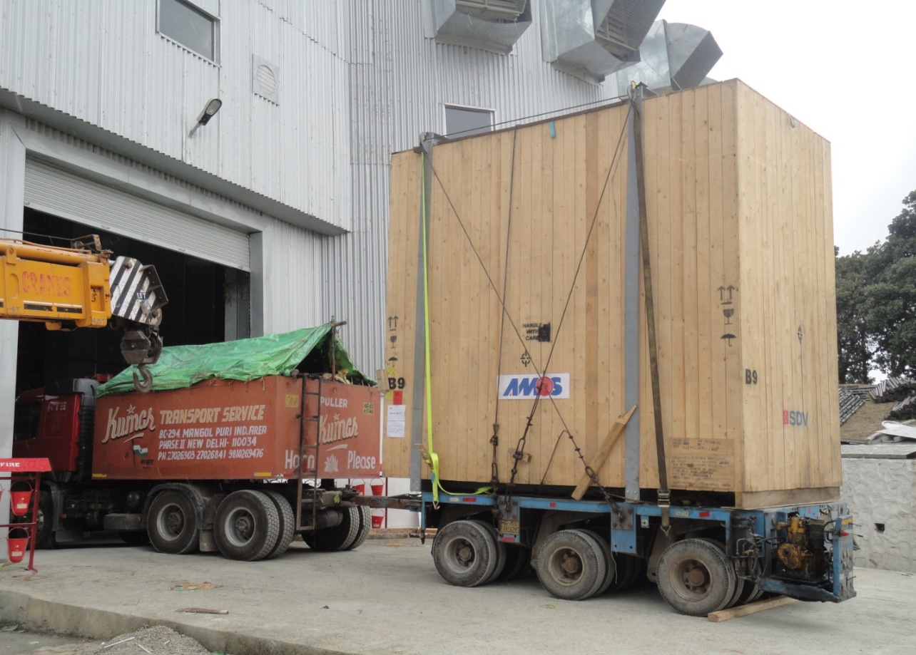
The transportation of telescope components to the site

Slide 18
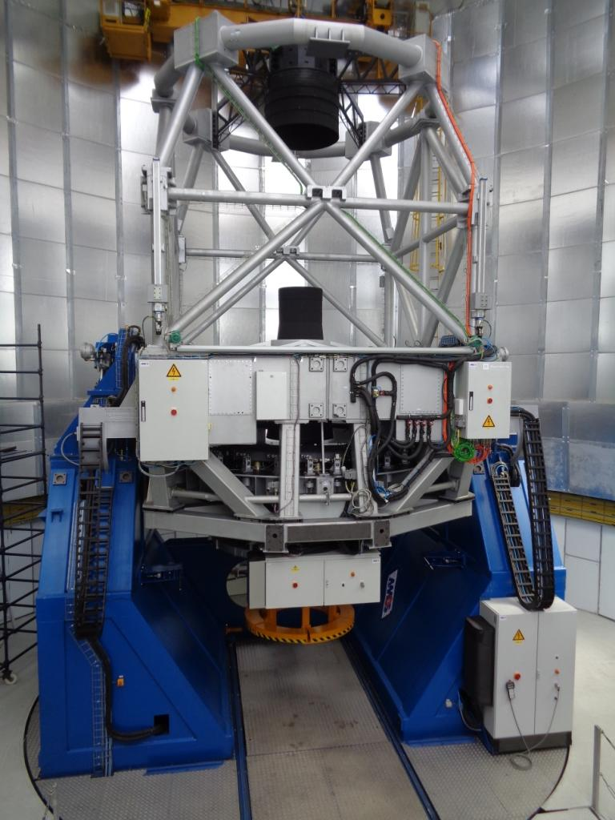
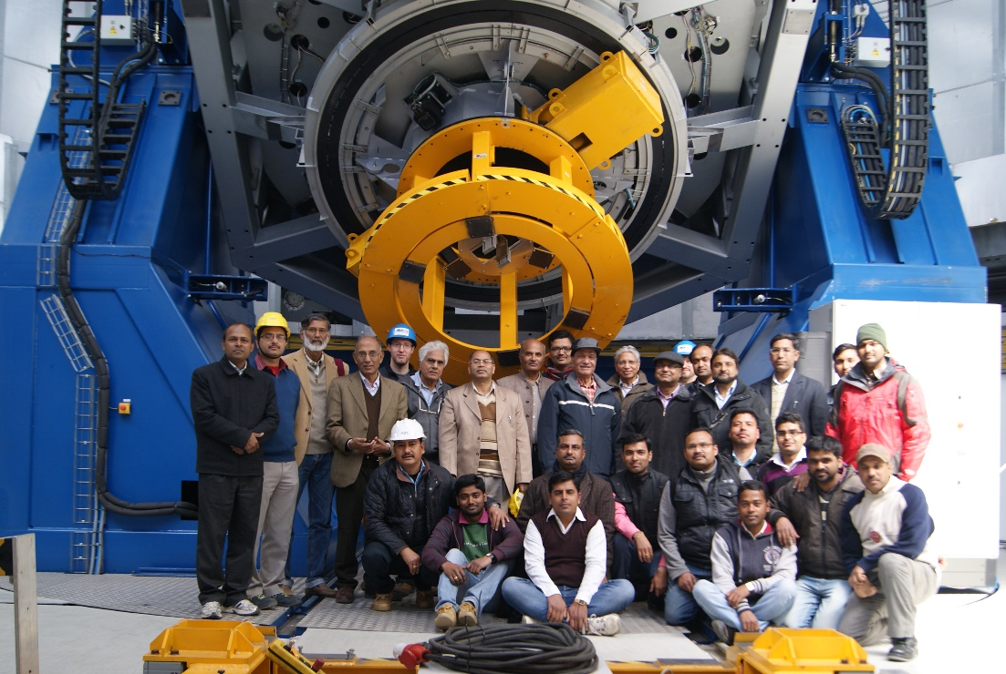
Assembly and integration of telescope at Devasthal
> Mechanical, electrical and optical
Parts integrated
> Refurbishment and repair activities
were also done
2014 Oct to 2015 Feb

Slide 19
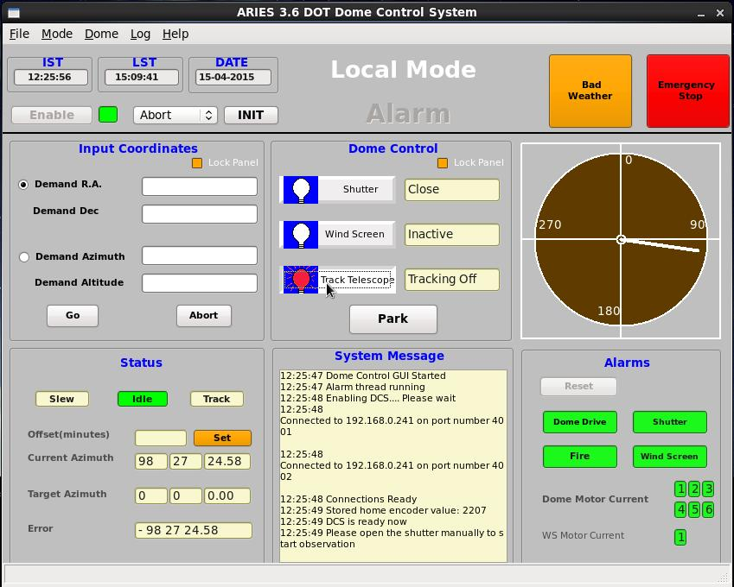
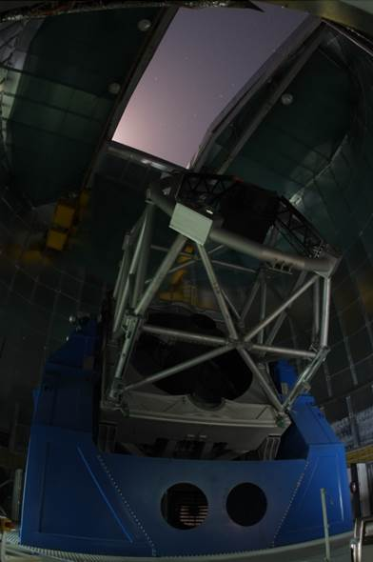
Synchronization of telescope with off-centred dome
2 0 1 3 to 2 0 1 5

Slide 20
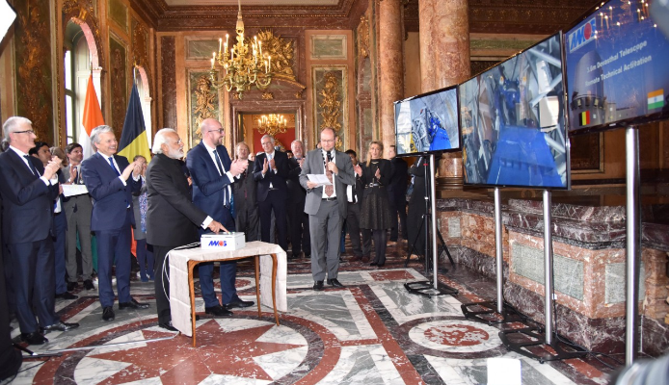
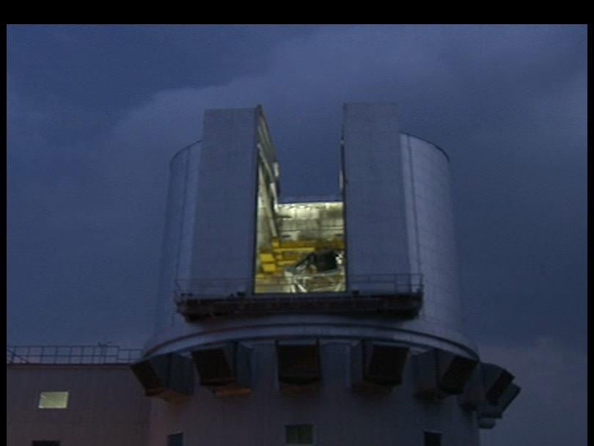
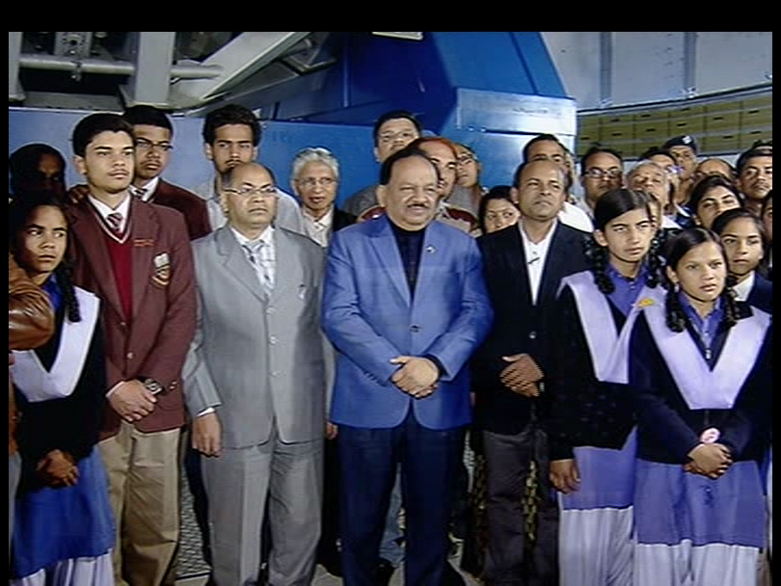
Mar 30, 2016 :
Remote Technical
Activation Event

Slide 21
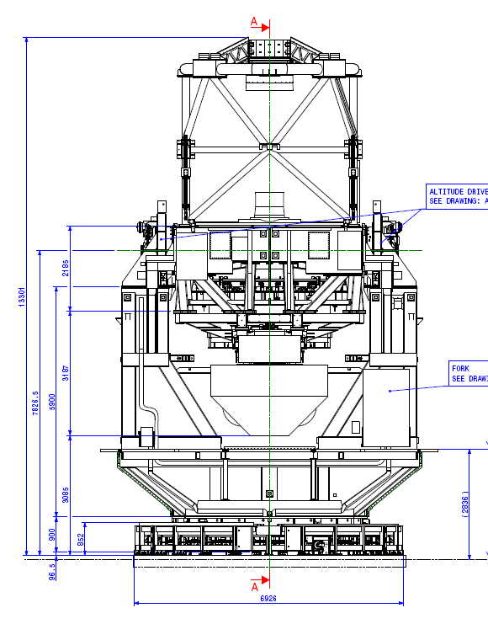
Imager Port Location and available space at the 3.6m Telescope

Slide 22
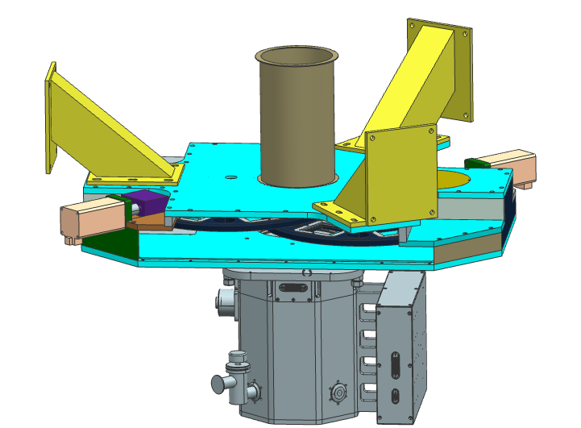
IMAGER
Instrument and Assembly Description
Stray light cover
Angle Bracket
Stepper motor
Muffett Gear
Filter Housing Assy.
4Kx4K CCD
Filter Wheel Assy.
In-house activity of ARIES

Slide 23
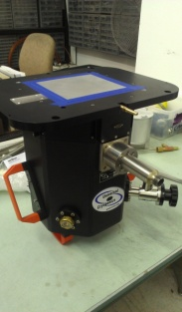
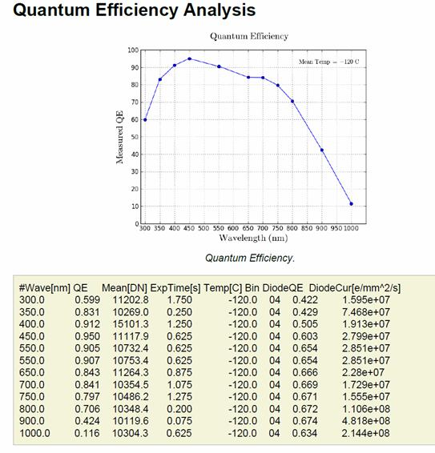
4KX4K CCD Camera, bought from STA USA.

Slide 24
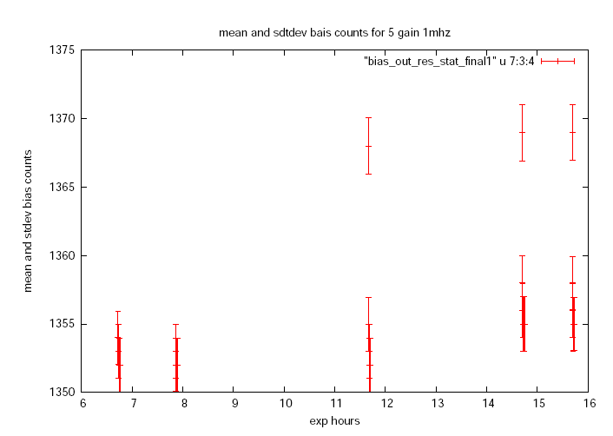
Bias Stability

Slide 25
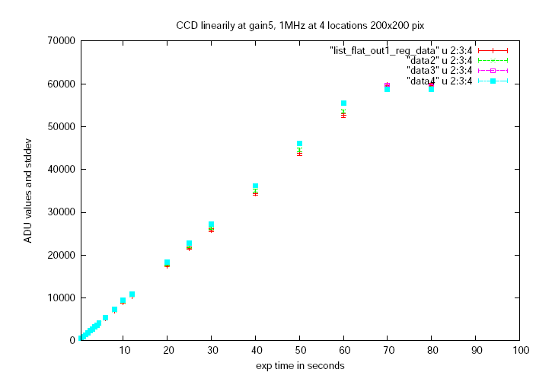
Linearity

Slide 26
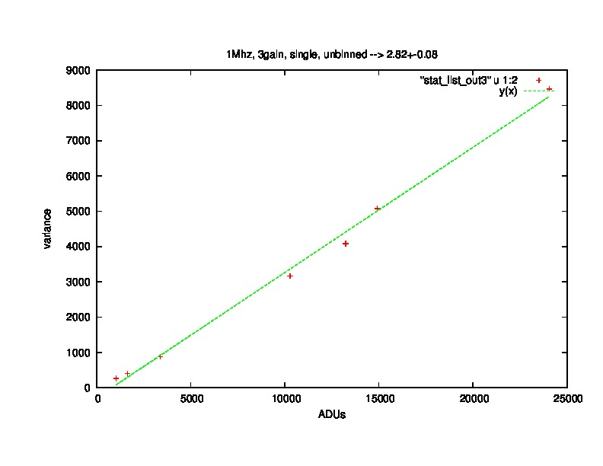
Photon Transfer curves:
Similar results were there for gain 5 too using the method suggested by Prof. T. P. Prabhu, i.e.
normalizing the individual flats by a master flat before getting the ADUs and Variance.

Slide 27
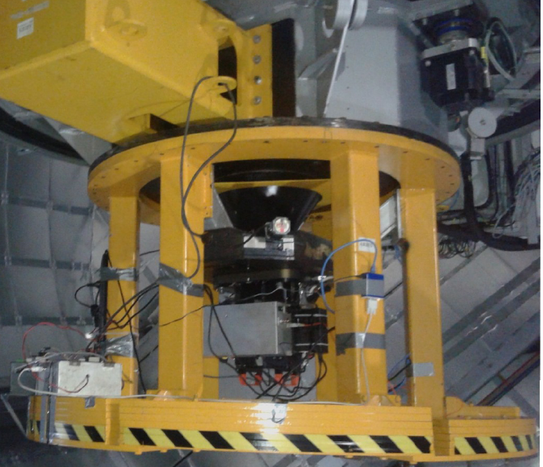
4Kx4K CCD Imager – axial port
FOV : 6.5 x 6.5 arcmin
Filters : 10, Broad-band Bessel UBVRI and SDSS ugriz
Scientific goals
Variable stars and asteroseismology
EUV-bright and soft X-ray sources
Study of GRB afterglows and Supernovae
Optical variability of AGNs
Galaxy photometry
Star clusters as a tool of stellar evolution
PMS stars in young clusters
Interacting binary systems
Other scientific goals (optical follow-up
of GMRT, ASTROSAT and ILMT sources)
4Kx4K, 15 micron CCD from M/s STA, USA,
LN2 Cooled system
Design and fabrication of filter automation done in-house

Slide 28
Input Parameters
M1 Diameter – 3.6 m, Effective reflecting area – 0.72
M1 reflectivity ~ 0.92+-0.02 (350 – 850nm),
M2 reflectivity ~ 0.86+-0.02 (400 -1000nm)
CCD Glass transmission ~ 0.98
Sec z ~ 1
Seeing FWHM ~ 1 arcsec, 2 arcsec
Aperture radius ~ 1*FWHM arcsec, ~ 2*FWHM arcsec
CCD Pixel size ~ 0.095555 arcsec/15 micron, 0.3822 arcsec in 4x4 bin
CCD Darknoise ~ 0.0000007 electrons/pix/sec
CCD readout noise ~ 2.5 at 100 kHz and 6.0 electrons at 1 MHz

Slide 29
Input Parameters
Wavelength (Å units) = (3652, 4448, 5505, 6588, 8060)
Wave width = (526, 1008, 827, 1568, 1542)
Zero points (erg/s/cm2/Å) = (428.0, 619.0, 360.0, 215.0, 111.0)*10^-11
Extinction Coefficients = (0.49, 0.32, 0.21, 0.13, 0.08)
Sky_mag (mag/arcsec2) = (22.1, 22.4, 21.3, 20.5, 18.9)
QE (STA, 15 micron) = ( 0.75, 0.96, 0.91, 0.86, 0.60)
Filter transmission = (0.62, 0.70, 0.88, 0.80, 0.88)

Slide 30
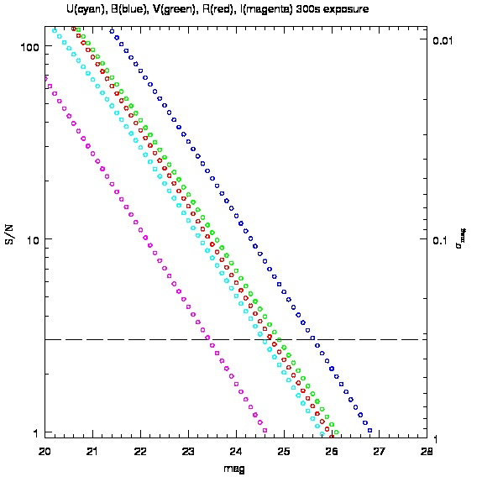

Slide 31
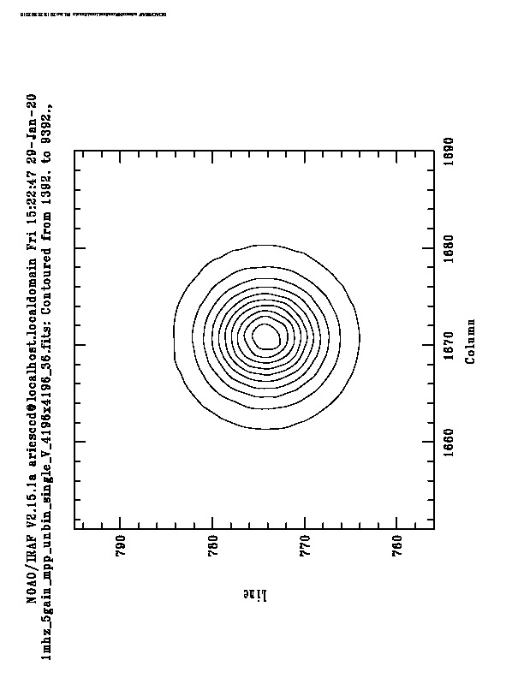
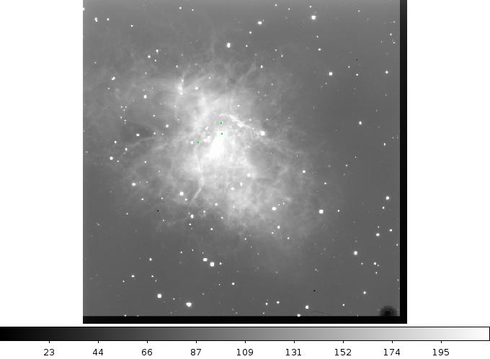
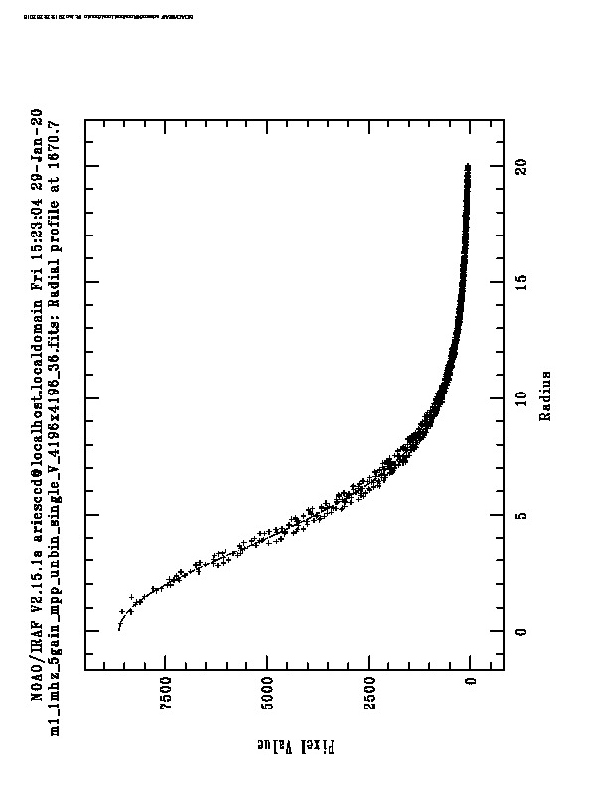
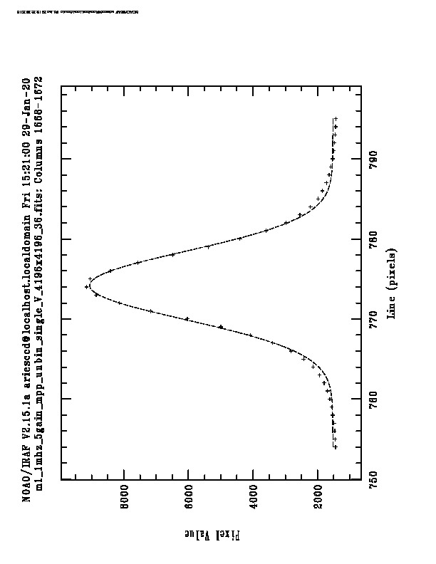
M1, Crab,
V-band,
180 sec,
1 MHz,
Gain 5,
Single,
raw,
fwhm 9 pixels,
2015 Dec, 11
↑

Slide 32
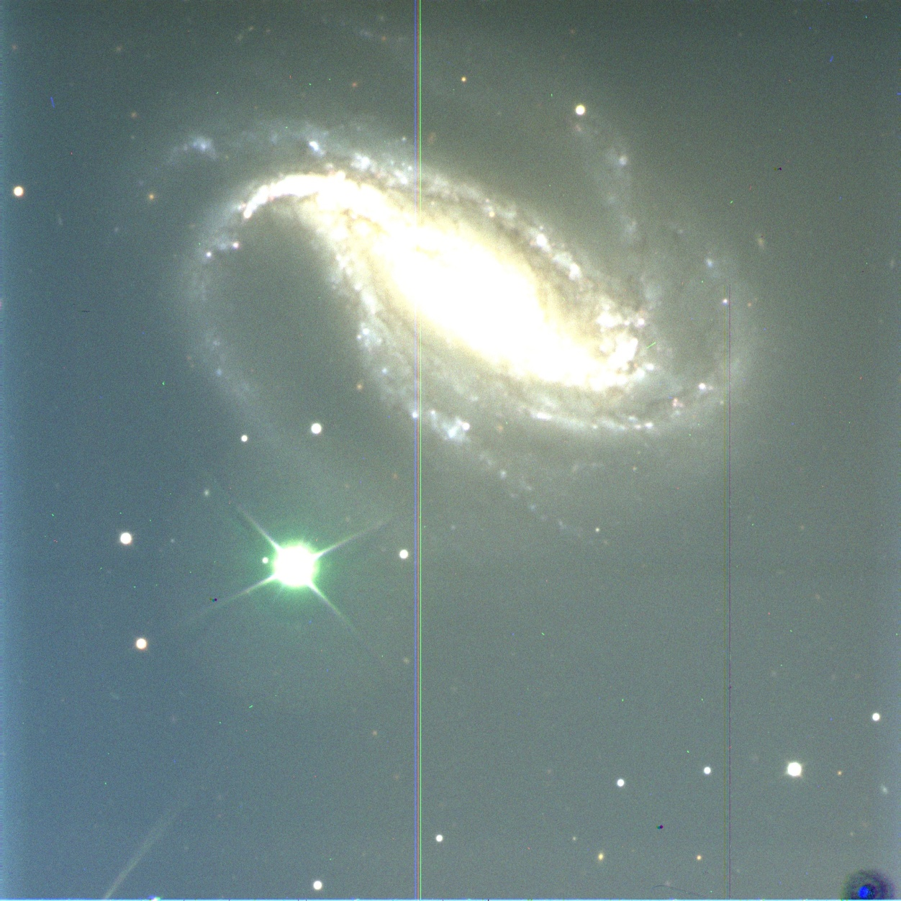
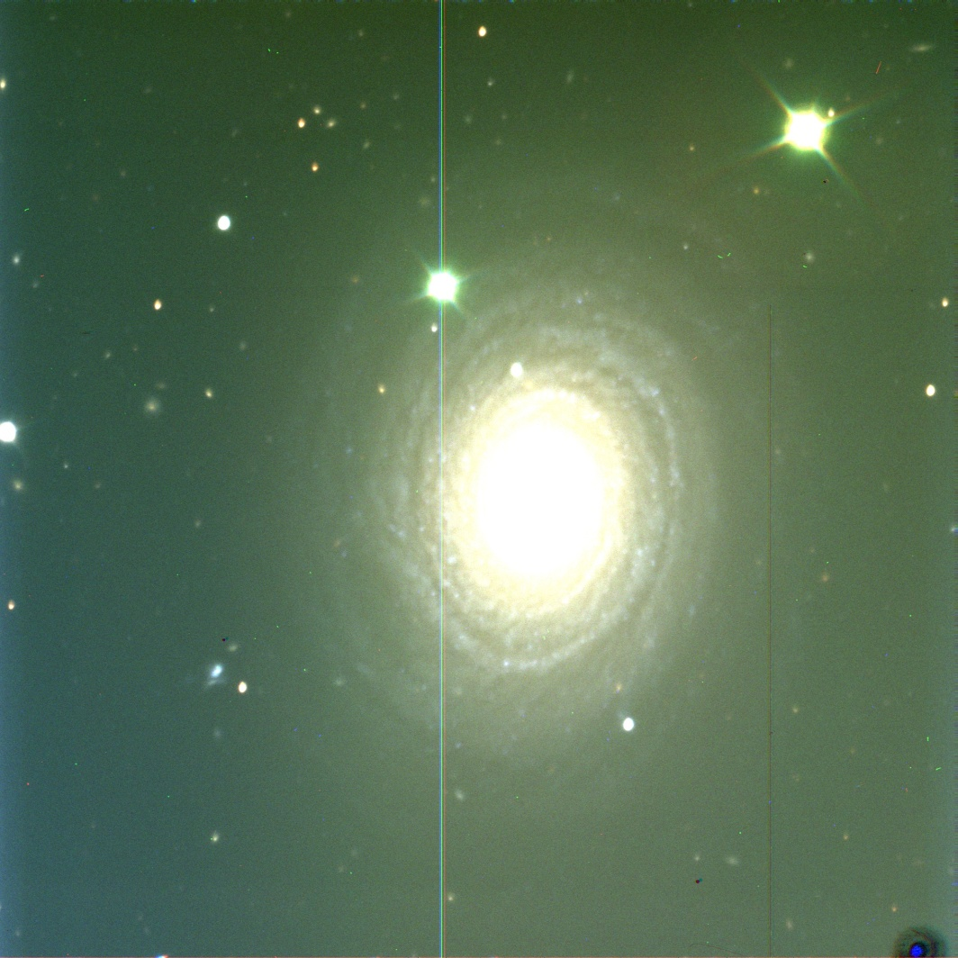
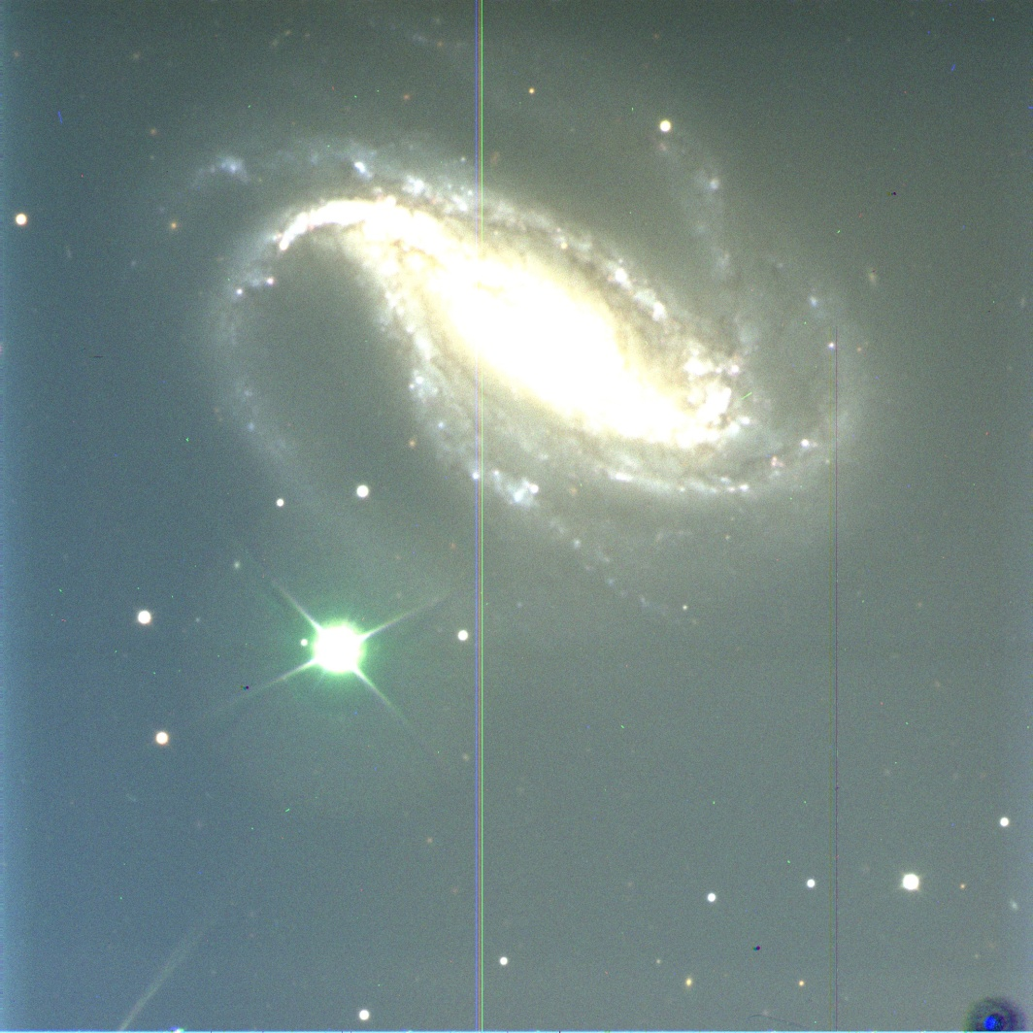
RGB image of NGC 488 spiral galaxy
in 3*200 sec .
RGB image of NGC 613 spiral galaxy
in 3*200 sec .

Slide 33
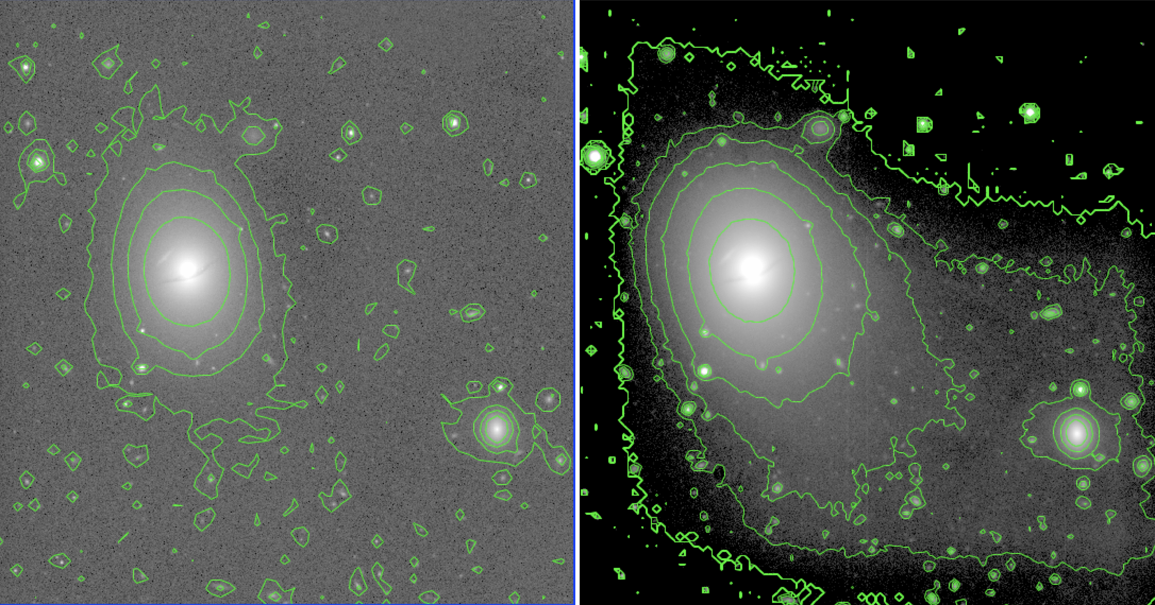
NGC 5486 and NGC 5487 (right) as seen by the CCD Imager + 3.6m DOT

Slide 34
NGC 4147 observations with the 4Kx4K CCD Imager +3.6m DOT:

Slide 36
CMD of the Globular cluster NGC 4147

Slide 37
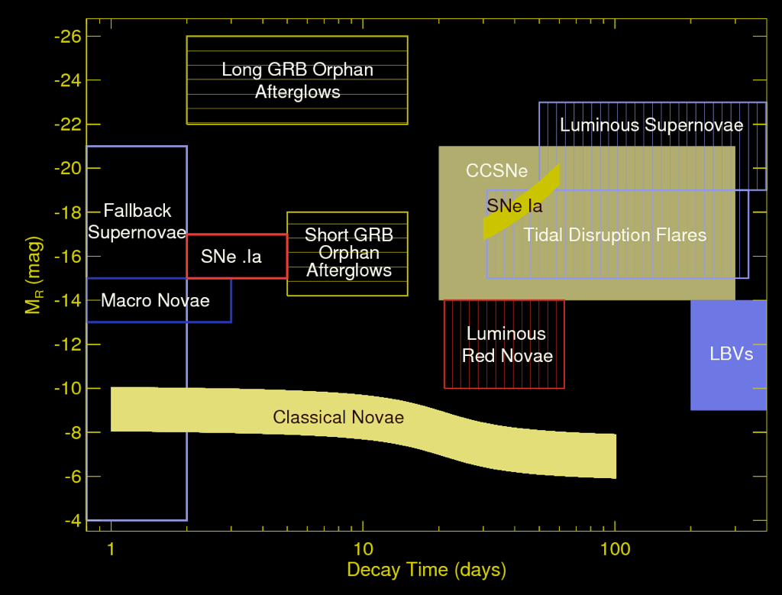
Optical Transients, Phase Space

Slide 38
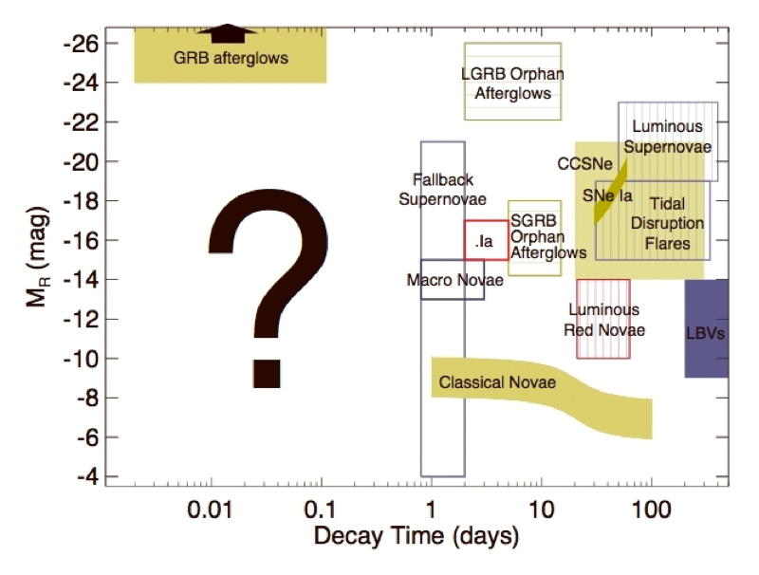
Optical Transients, Phase Space

Slide 40
Internal shocks Vs. magnetic reconnection ? (Kumar & Crumley 2015, Granot 2016)

Slide 41
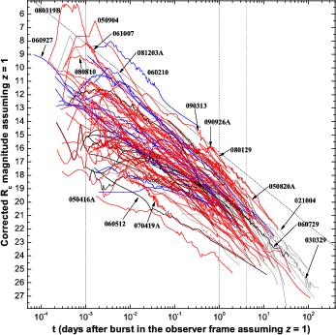
Optical afterglows: (Kumar & Zhang 2016, review)
Granot & Sari 2002, Kumar & Panaitescu 2001, Sari et al. 1998, 1999, Rhoads 1999
and many more
(Kann et al. 2017)
111209A
130925A
(Kann et al. 2010)

Slide 42
arXiv:1605:01303,
Turpin et al. 2016

Slide 43
Optical Afterglows, issues for the 3.6m DOT:
* On similar time-scale, optical light-curves decay differently than X-ray
(Late time central engine activity /
Central Engine Afterglow Vs. Fireball Afterglow /
Diverse Origins / Physical mechanisms / multi-jets/structured-jet etc. )
* Ultra-long GRBs and Supernova-GRB connections
(Systematic study of special LGRBs/ search for Supernovae in nearby LRGBs
/ Multi-band studies of nearby hosts)
* For more than 35% of localized GRBs, No observed optical emission, Dark bursts
(Host Obscured / Intrinsically dim / High-redshift Events)
* Short duration Gamma-ray bursts and search for Kilonovae
(Systematic search / Jet-breaks /
study of nearby hosts / Kilo-nova emissions)
Notes:
43

Slide 44


Off-axis emission / Structured Outflow:
Early rising light curves at optical frequencies can
also be observed if the observer is sitting off-axis
i.e. a geometric effect (Zhang & Meszaros 2002;
Kumar & Granot 2003).
Or the outflow itself is structured (JG, Ramirez-Ruiz & Perna 2005)
XRFs/XRRs as off-axis GRBs?
Faint at BAT energies, lower E_{peak,} lower Г, less bright at optical, later/flatter rise/fall
at optical frequencies?
Notes:
44

Slide 45

Dark GRBs:
35% population of well-localized Swift GRBs is dark,
X-ray afterglow but no optical to deeper limits
Possible explanations:
1. Low-density scenario
(ejecta decelerate in a low density environment)
2. High-Z scenario
(visible light is extinguished due to absorption)
3. Dusty environments
(exploding in thick and dusty environment so
afterglow is suppressed by extinction)
Also, higher N_{H} so metal rich (dust rich) environment
Malendri et al. 2012, van der Horst
et al. 2009, Jakobasson et al. 2004

Slide 46

Continuum of GRBs and CCSNe:
Soderberg et al., 2006, 2010
Relativistic ejecta:
Nearest (z < 0.1) GRBs are:
- outliers
- sub-energetic
Un-collimated
Number density is very less in
nearby universe

Slide 47


Afterglow properties of S-GRBs:
S-GRBs afterglows are in general fainter
With super-imposed variability, late time
Central engine activity, platue at BAT-XRT
frequencies
Afterglow decay nature is similar to what
Have been seen in case of L-GRBs
Less dense environment ?
Less energetic?

Slide 48


Afterglow properties of S-GRBs: Prompt Vs. Afterglow correlations
Berger et al. 2014

Slide 49

SGRBs, Kilonova models : arXiv:1505:01195

Slide 50

Disk-wind outflows model with disk mass 0.03 M_sun: Kasan, Fernandez & Metzger, 2015, MNRAS

Slide 51

Disk-wind outflows model with disk mass 0.03 M_sun: Kasan,Fernandez,Metzger, 2015, MNRAS

Slide 52

Disk-wind outflows model with a rather massive disk mass 0.3 M_sun, more Neutron-rich ejecta: (Tanaka et al. 2014, Hotokezaka et al. 2013)

Slide 53


Slide 55
Near Future Instruments for the 3.6m DOT

Slide 56

2) Faint object and spectrograph Camera – axial port
Wavelength range : 350-900 nm
Imaging mode :
- FOV : 14 x 14 arcmin
- Broad and narrow band filters
- 0.2 arcsec pixel resolution, 4k CCD chip
Long-slit spectroscopy mode :
- Resolution : 250-2000
- Normal and VPH gratings
THE FOCAL PLANE INSTRUMENTS
Imaging : 25 mg in 30-min in V-band with S/N ~5
Spectroscopy : 20 mag in 10-min at 0.5 micron with S/N ~5

Slide 57


3) TIFR-ARIES VIS-NIR Spectrograph - axial
(Dec 2017)
Design phase
Wavelength range : 600-2500 nm
Imaging : 60 x 60 arcsec
Long-slit spectroscopy mode :
- resolution : 200 and 2000
- cross-dispersed/prism
Limiting Magnitude(K -Band):
14.5 in 10 min exp
16 mag in 1 hr exp
THE FOCAL PLANE INSTRUMENTS
Science Drivers :
- Low mass stars (red and brown dwarfs)
- star formation
- spectral library VISNIR

Slide 58


4) High resolution Optical spectrograph – axial port
Optical design completed
> Fiber fed
> 30k and 60k resolution
> 377 – 900 nm
> 20m/s stability
THE FOCAL PLANE INSTRUMENTS
Science Drivers ;
- Astero-seismology
- Abundance studies
- Doppler imaging of spotted stars

Slide 59



5) Fast CCD photometer – side port
Preliminary design completed
400-800nm
2k ccd, 13 micron
6x6 arcmin
Time-variability study CP, CV, WD
THE FOCAL PLANE INSTRUMENTS

Slide 60

6) Integral Field Spectrograph (IUCAA – ARIES) – side port
Implementation phase
THE FOCAL PLANE INSTRUMENTS

Slide 61
Next Cycle is open (http://www.aries.res.in/dot/):
● 2017 October – 2018 January
● Shared Risk
● Upgraded Imager and TIRCAM2
● Engineering time and Instrument Test time (FOSC, TANSPEC) to be estimated
● Director's Discretionary Time?, ToO mode of observations?
● Timeline
– 03 July Call for Proposals
– 01 August deadline for submission
– 25 Aug DTAC meeting
– 1 Sep finalize schedule
Belgium – 7 %
ARIES – 33%
Astronomical Community – 60%

Slide 62
Thanks..

